Slide 1

EMAIL SPAM CLASSIFIER PROJECT
Submitted By:
Lakshmi Rajendra Thute

Slide 2

INTRODUCTION
The SMS Spam Collection is a set of SMS’S tagged messages that have been collected for SMS Spam research. It contains one set of SMS messages in English of 5,574 messages, tagged according being ham (legitimate) or spam.
Spam Detector is used to detect unwanted, malicious and virus infected texts and helps to separate them from the no spam texts. It uses a binary type of classification containing the labels such as ‘ham’ (no spam) and spam. Application of this can be seen in Google Mail (GMAIL) where it segregates the spam emails to prevent them from getting into the user’s inbox.

Slide 3
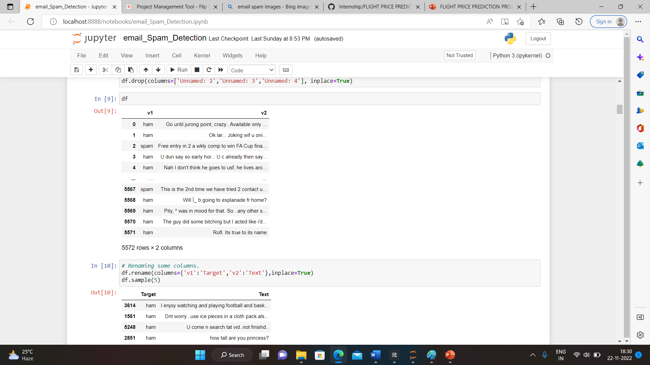
ANALYTICAL PROBLEM FRAMING
We got the dataset available from client, and we must build a model that is able to detect the spam emails or SMSs and to sort them from ham emails. The dataset contains total 5 columns, they are v1, v2, Unnamed: 2, Unnamed: 3, Unnamed: 4, from which Unnamed: 2, Unnamed: 3, Unnamed: 4, are irrelevant as they only contain null values, so we dropped them.

Slide 4
DATA COLLECTION AND PREPROCESSING
• Mathematical/ Analytical Modelling of the Problem
Here I firstly read the dataset in jypyter notebook for cleaning the dataset I use pre-processing techniques, then did the Exploratory Data Analysis, then Encoding and lastly model Building and Evaluation.
• Data Sources and their formats
I got the dataset in CSV format, and I read the data in Jupyter Notebook using pandas data frame.
• Data Pre-processing Done
The dataset contains some irrelevant columns firstly we dropped that columns then we check the unique and duplicate values in the dataset, and removed them

Slide 5
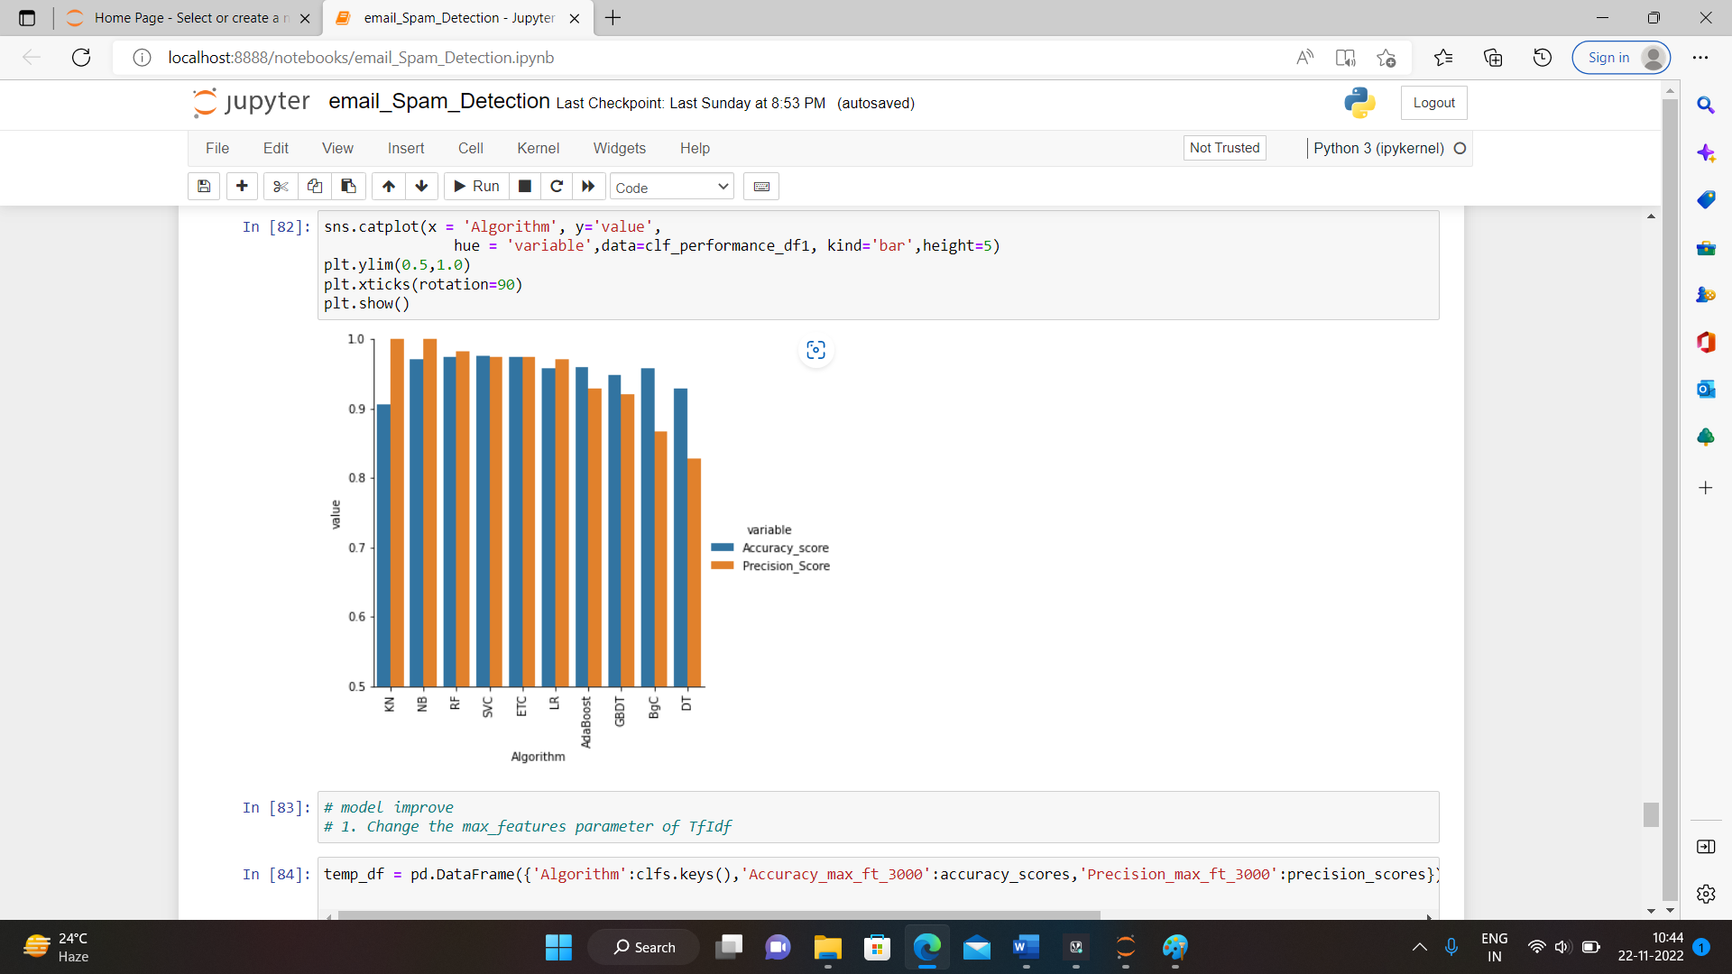
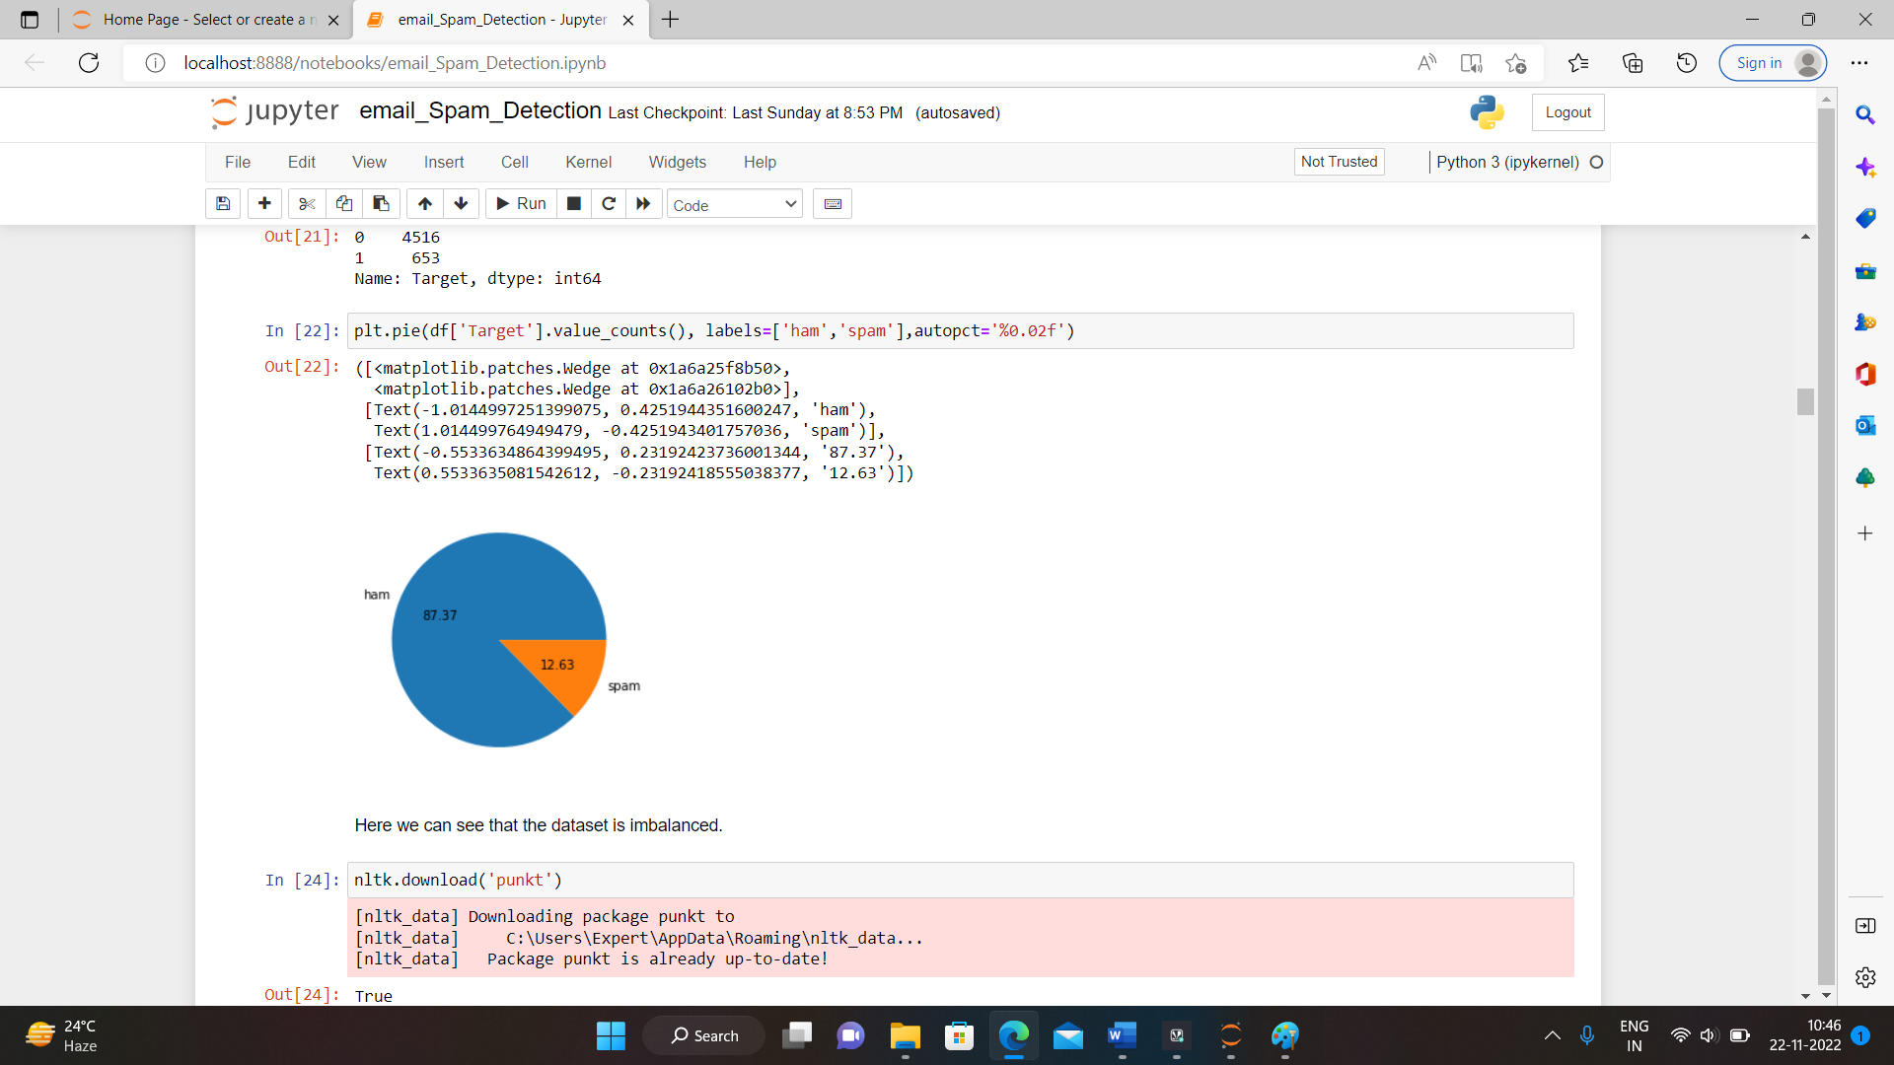
EXPLORATORY DATA ANALYSIS

Slide 6
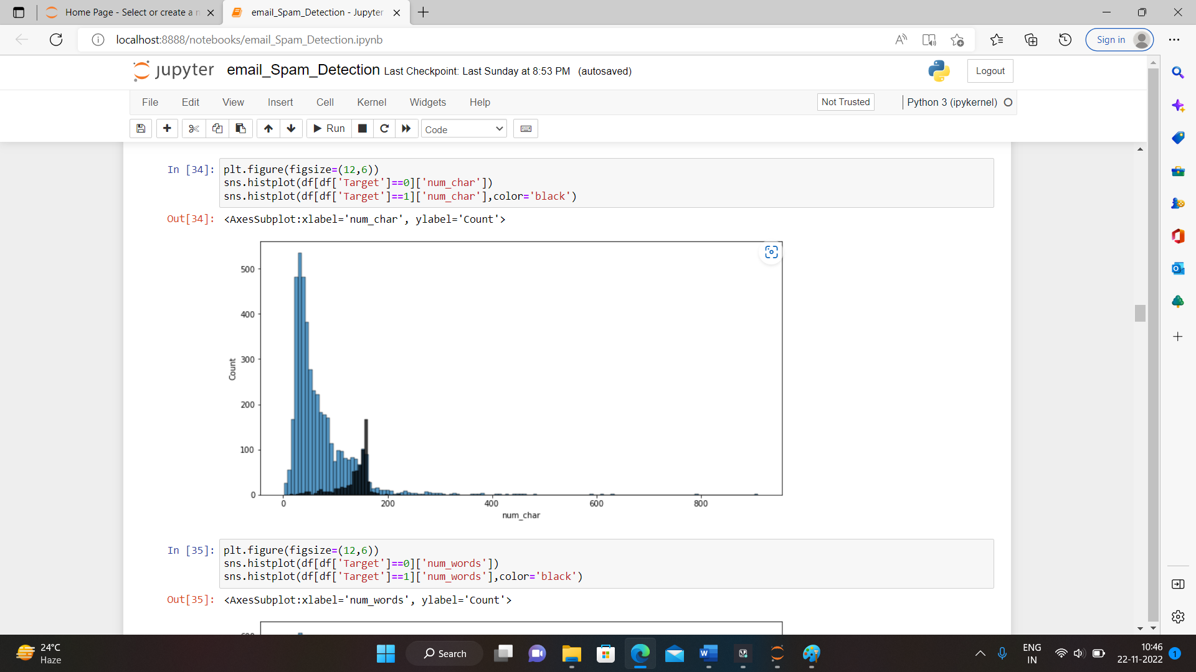
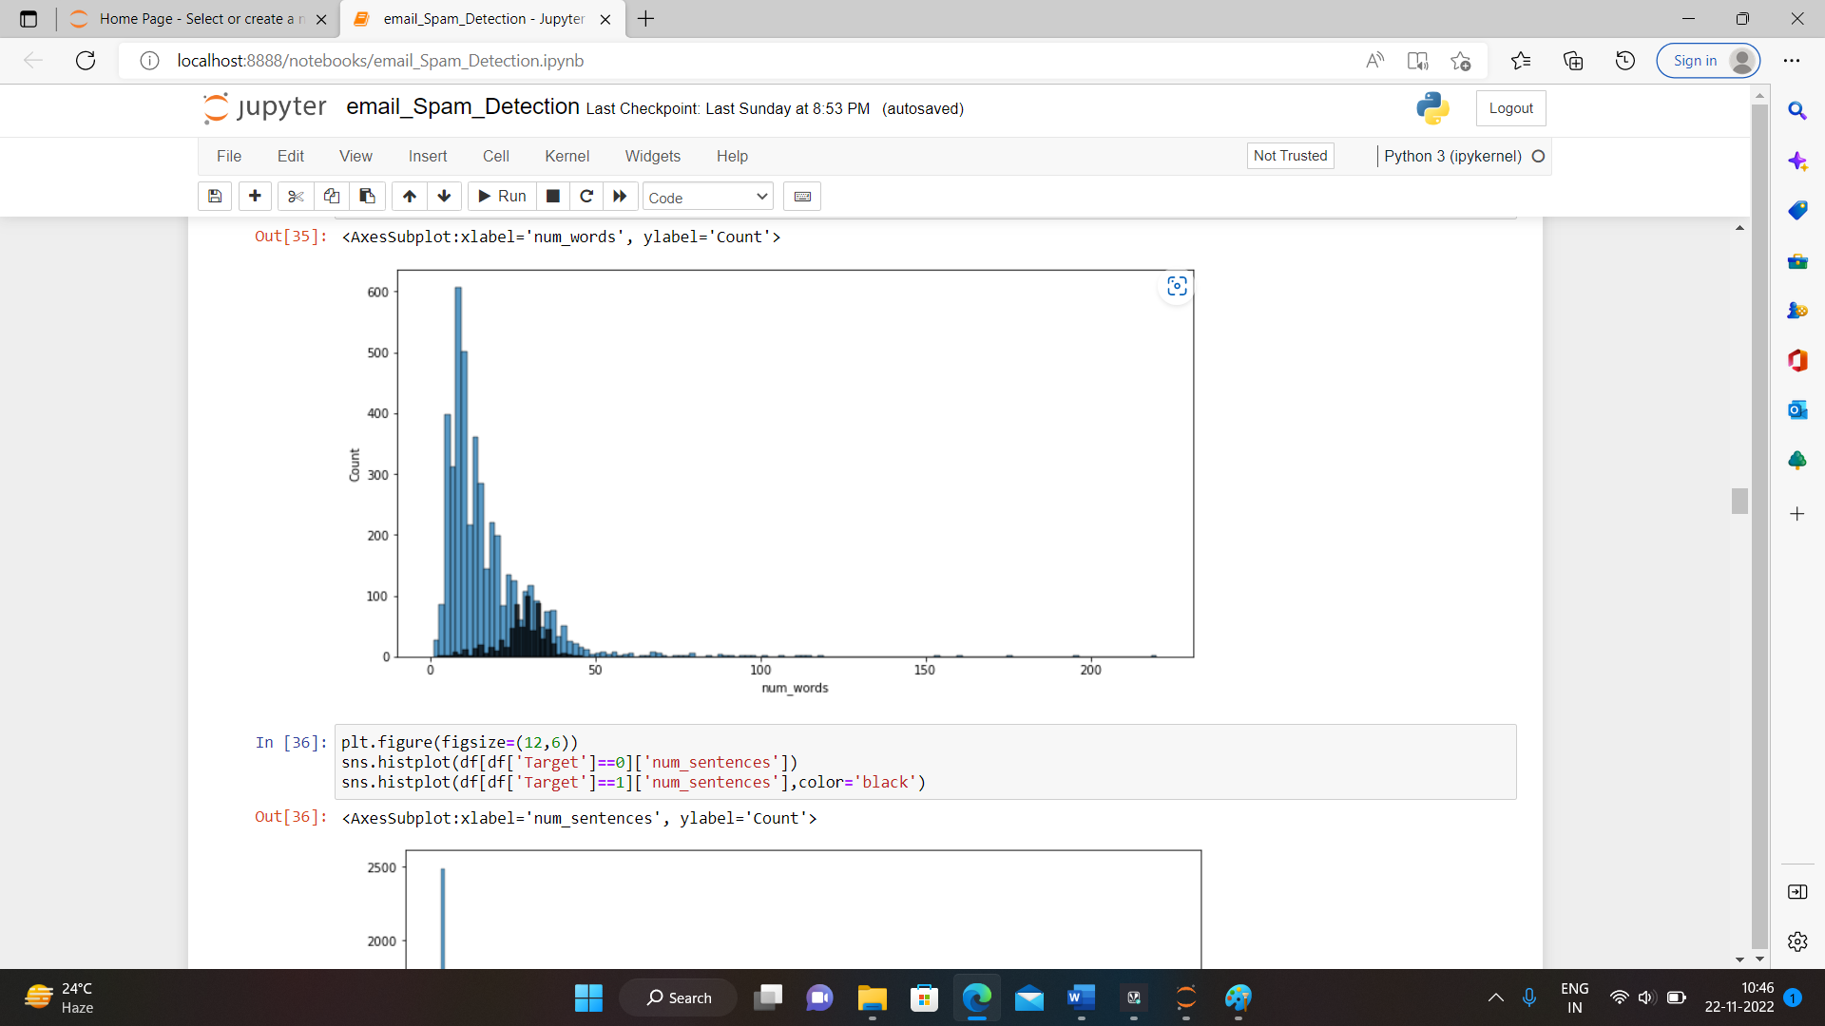

Slide 7
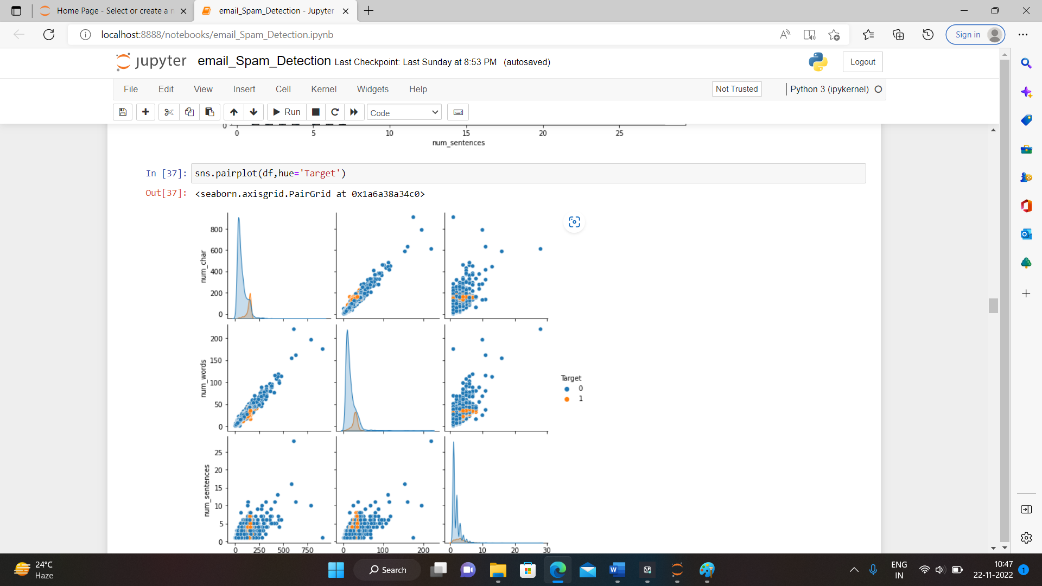
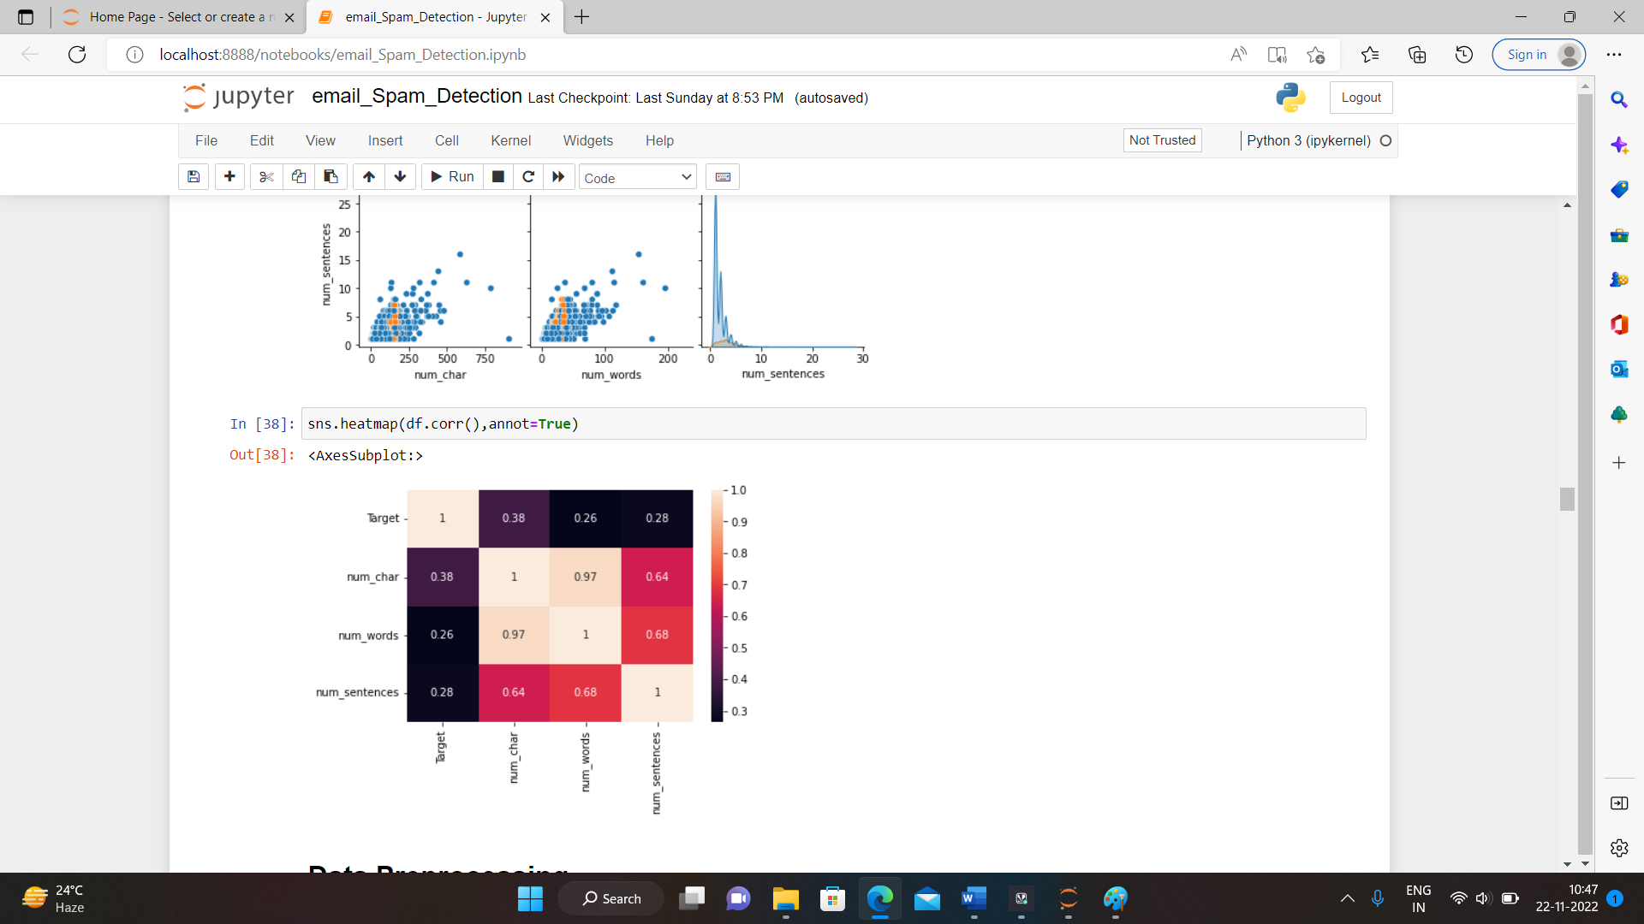

Slide 8
OBSERVATIONS
From the pie chart we observe that the dataset is imbalanced.
Most of the numeric characters lies in between 0 to 200.
Most number of words lies in between 0 to 50.
Most number of sentences lies in between 0 to 5.
Most of the columns shows linear relationships between each other’s.

Slide 9
INTERPRETATION OF RESULTS
Most of the emails are ham that means non-spam and very less are spam, there are total 87.37 ham emails and 12.63 are spam emails.

Slide 10
THANK YOU

